Slide 1








The Restaurant Types in New York
The Battle of Neighborhoods
Klims Lavriks
April, 2021

Slide 2



OUTLINE
Introduction
Data
Methodology Section
Data preparation
Restaurant information (Foursquare API)
Machine learnings (K-means Clustering)
Exploratory data analysis
Results
Discussion
Observations
Recommendations
Conclusion
Appendix

Slide 3

INTRODUCTION
New York City is the nation's most attractive destination for visitors.
It attracts almost one-third of all foreign visitors to the United States.
No surprise, availability of one or the other type restaurants plays important role in travelers' decision over their stay location.
My client is international travel company who seeks to investigate what types of restaurants are prevailing in various neighborhoods of New York in order to provide well-informed advises to their customers.
This report presents analysis of most popular types of restaurants in each neighborhood of New York and maps clustered neighborhoods.

Slide 4

DATA
The report retrieves data on:
New York neighborhoods
Source: data is scraped from Wikipedia page (full link provided in appendix)
Neighborhood location (long/lat)
Source: GeoPy geocoding web services
Restaurant information
Source: Foursquare API

Slide 5

METHODOLOGY SECTION
This section contains key steps undertaken to retrieve relevant restaurant information in NY neighborhoods and provide an indication to what type of restaurants are dominant in each neighborhood.
Finally, clustering technique will be explained that was used to aggregate neighborhoods into high-level groups.

Slide 6
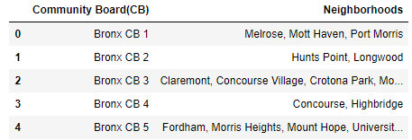
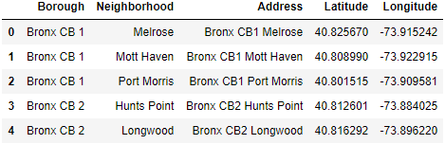
Data preparation I
First, neighborhood data is scraped from Wikipedia page (see top right).
Data is segregated into separate neighborhoods and joined with borough information to form an address line.
Created address line is used in search request for identifying long/lat data through GeoPy geolocator (see bottom right).

Slide 7
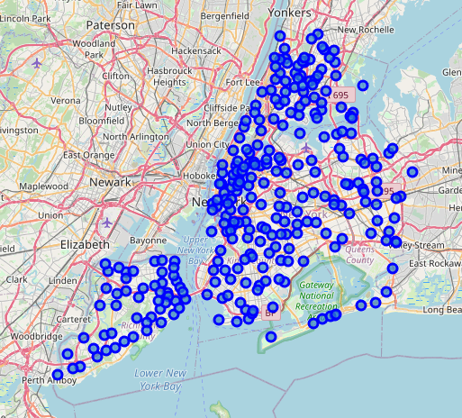
Data preparation II
To ensure neighborhoods located correctly, Folium library in Python used to map found locations.

Slide 8
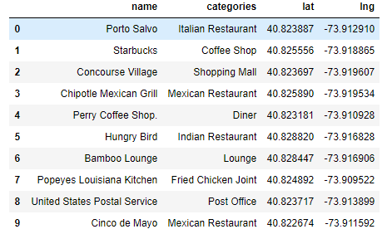
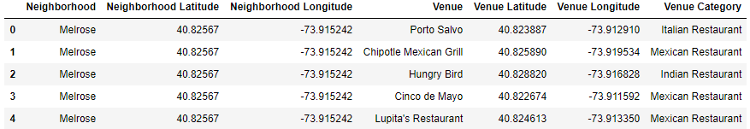
Restaurant information (Foursquare API)
Foursquare API is used to identify 100 nearby venues for each of located NY neighborhoods.
Only venues containing "Restaurant" word in venue category label are used in the analysis.
To support further quality of the analysis only those neighborhoods selected which have at least 5 different types of restaurants.

Slide 9
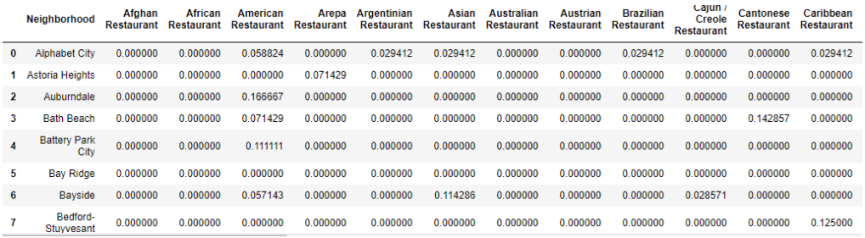
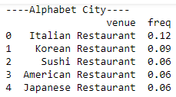
Machine learnings (K-means Clustering) I
To prepare restaurant data for clustering process, one hot encoding is applied for getting dummies of restaurant types.
By grouping data and calculating mean for each restaurant type we obtain desired ranking.

Slide 10
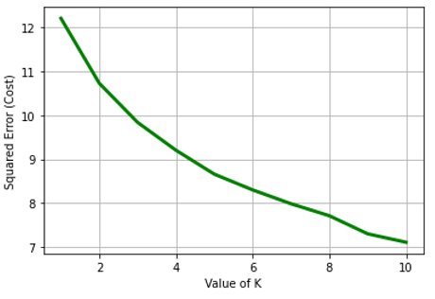
Machine learnings (K-means Clustering) II
Now, when data is ready for clustering process, it is pushed through k-means estimator to find the best value for k parameter.
The resulting plot of squared errors points to the value of 5 for k parameter based on "Curve Elbow" method.
It means we are going to have our neighborhoods split into 5 clusters.

Slide 11
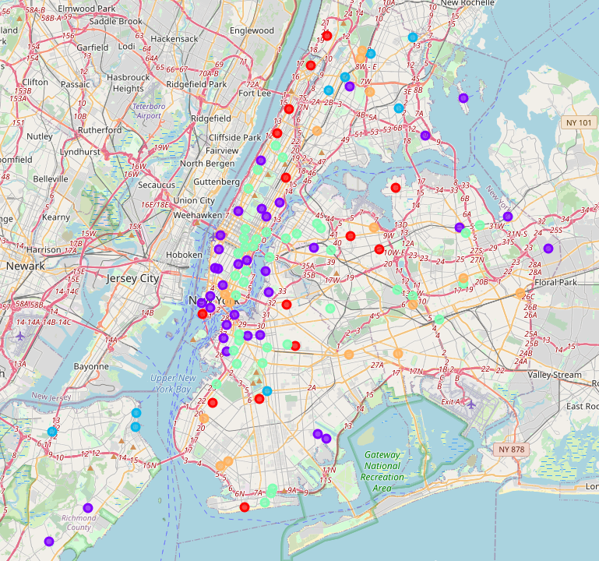
Machine learnings (K-means Clustering) III
Neighborhoods are eventually grouped into 5 clusters and are mapped using Folium library in Python.
The mapped locations represent neighborhoods which have a great variety of local restaurants with color coding applied to separate different clusters.
The color codes and their relation to clusters will be explained in detail in "Explanatory Data Analysis" section.

Slide 12
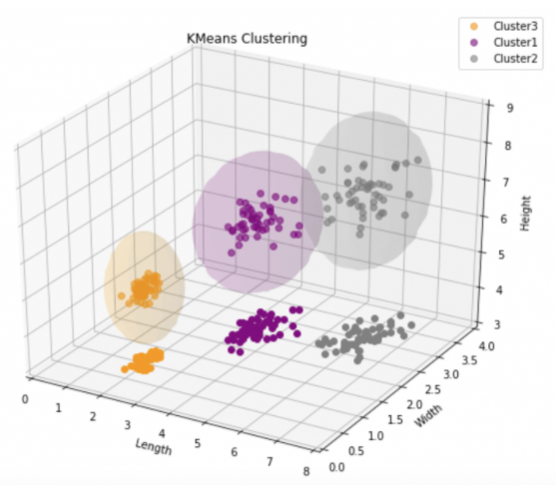
EXPLORATORY DATA ANALYSIS
In the following slides all clusters will be examined separately with objective to define dominant type(s) of restaurant in each neighborhood.
Raw data used for clustering provides us with top most common restaurants in the neighborhood. However to draw a conclusion over a dominant type, examining only top 2 most common restaurants must be sufficient for reaching reliable results.

Slide 13
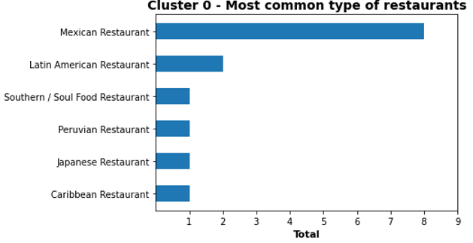
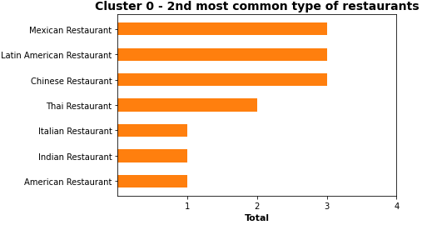
Cluster 0 - (red pointers on the map)
Dominant type of restaurant:
We can clearly see Mexican being dominant type of restaurant. We can add Latin American restaurants to the dominance also. They earned 2nd place in both charts.
Neighborhoods covered:
Total: 14
Location: Neighborhoods are identified in all areas of New York apart from Staten Island and avoiding congested NY city locations.

Slide 14
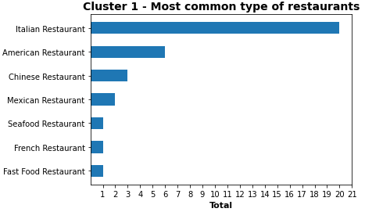
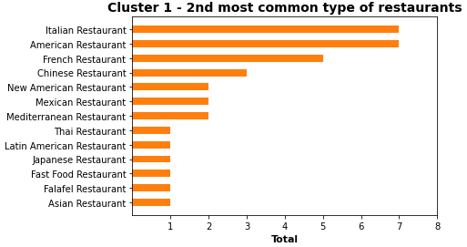
Cluster 1 - (purple pointers on the map)
Dominant type of restaurant:
Italian cuisine is most popular in cluster 1 with American restaurants earning confident 2nd place.
Neighborhoods covered:
Total: 34
Location: Neighborhoods are identified in all areas of New York without an exception with majority concentrated in Downtown and north-west part of Brooklyn.

Slide 15
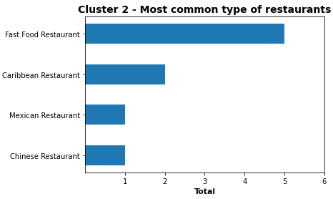
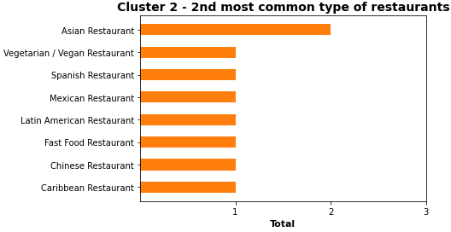
Cluster 2 - (light blue pointers on the map)
Dominant type of restaurant:
This cluster covers a small number of neighborhoods which are mainly popular with their fast food chain restaurants.
Neighborhoods covered:
Total: 9
Location: Staten Island & north part of Bronx.

Slide 16
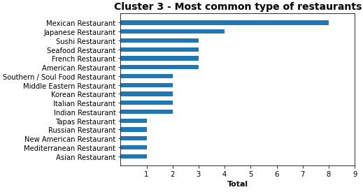
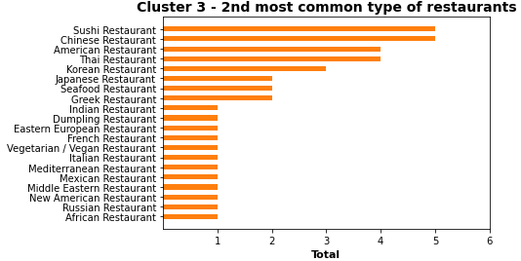
Cluster 3 - (light green pointers on the map)
Dominant type of restaurant:
Though clear dominance belongs to Mexican as the most common restaurant (remember, Mexican selected as top type for cluster 0 also), it's important to notice that neighborhood is rich with its Far East restaurants (Japanese, Chinese, Thai, Korean). Especially popular are Japanese restaurants, cause Sushi places belong to Japanese cuisine
Neighborhoods covered:
Total: 39
Location: Manhattan, Brooklyn and Queens

Slide 17
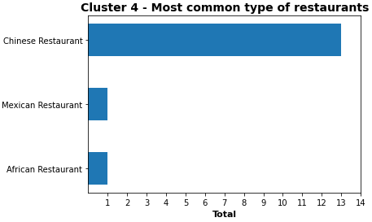
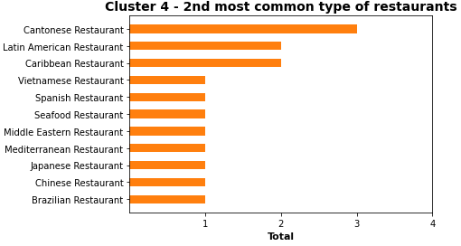
Cluster 4 - (orange pointers on the map)
Dominant type of restaurant:
In cluster 4 Chinese (and Cantonese, which is basically the same cuisine) is clearly top type of restaurant in the neighborhoods.
Neighborhoods covered:
Total: 15
Location: Neighborhoods are identified in all areas of New York apart from Staten Island. There are no locations identified in Manhattan apart from two neighborhoods in obvious Chinatown area.

Slide 18
RESULTS
It goes without saying that New York has no shortage of restaurants in its area.
111 neighborhoods have at least five type of restaurants in radius of 500m from its center point.
Majority of neighborhoods are dominated by Mexican, Far East, Italian and American restaurants. These 4 also dominate most parts of Manhattan, especially central and city locations.
Quite a few neighborhoods have clear dominance of Chinese and Cantonese restaurants.
Only a few neighborhoods located in Staten Island and north Bronx have fast food chains indicated as the most popular restaurants.

Slide 19


DISCUSSION

Slide 20
Observations
Though it's widely known that New York is crammed with numerous fast food stores, only a few neighborhoods identified to have fast food restaurants being dominant in the area. That is likely to be explained by the fact that not all fast food places qualify for a "restaurant" title, and hence could be marked under different venue category in Foursquare API.
A small number of restaurant type instances selected for each neighborhood (5) together with a great variety of different types of restaurants in theory cause clustering process to be fairly inefficient. Though obtained clusters quite clearly defined dominant places in most neighborhoods that are close to be true.
It was a surprise not to see any neighborhood where Indian restaurants would dominate the area. It could be either because those are spread evenly across New York neighborhoods and are not concentrated in any specific area, or due to data incompleteness retrieved from Foursquare API.

Slide 21
Recommendations
This project can certainly benefit from split-rank logic which is not applied for cases when number of most common restaurant places is identified the same. For example, if a neighborhood area has 2 of each of 5 restaurant types, any restaurant can be selected as a dominant.
New York neighborhoods can be very different in size and venue search radius could have been modified for each area according to its size to cover more restaurants
Quite a few neighborhoods were identified to have only a few number of restaurants and were removed from the analysis. Since data relies on limited 100 venues that can be extracted from Foursquare API in a single search request, more restaurant locations could have been captured if a workaround solution found to bypass this limit.

Slide 22

CONCLUSION
To conclude, this project has served well for outlining restaurant type dominance in various neighborhoods of New York and will be a great help to travel agents for forming informed advise on restaurant locations to their clients.
The analysis provides a good glimpse into what cuisines can be tried out in one or the other neighborhood of New York, however there are certain aspects that can be improved in order to improve quality of outputs presented.
As a final note, the analysis carried out in this project is dependent on the accuracy of Four Square data. A more comprehensive analysis would benefit from incorporating data from other external databases.

Slide 23


APPENDIX

Slide 24
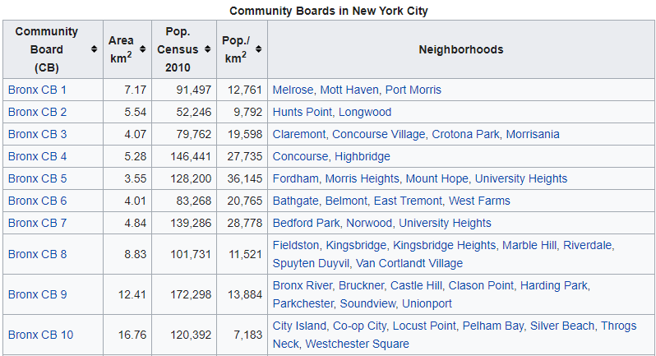
Neighborhoods in New York City
Resource link: https://en.wikipedia.org/wiki/Neighborhoods_in_New_York_City
Resource table snapshot:

Slide 25

Foursquare API
Resource link: https://developer.foursquare.com/
Resource website snapshot:

